Slide 1
CPSC 233: Demo 1
Haohu Shen, Alexandra Tenney, Lan Jin, Dwight Pittman, Tiffany Tang

Slide 2
Agenda
Updated Project Proposal Review
Updated Team Contract Review
Class Diagram (UML)
README File Overview
Demo of Admin Interface
Demo of Faculty Interface
Demo of Student Interface
Q and A

Slide 3
Updated Project Proposal Review
Important Changes:
Increased Scope of the Project:
We will create a web scraper with the ability to scrape course information off the University of Calgary website (https://www.ucalgary.ca/pubs/calendar/current/index.html)
Does not interact with the system, just expands the database prior to use

Slide 4
Updated Team Contract Review
Important Changes:
Updated Meeting Schedule:
Original 2 hour Thursday meetings changed to two 1 hour meetings on both tuesday and thursday
Additional Role’s:
Lan Jin - In charge of the UML and updating the diagram through-out the project
Tiffany Tang and Dwight Pittman - In charge of GUI implementation

Slide 5
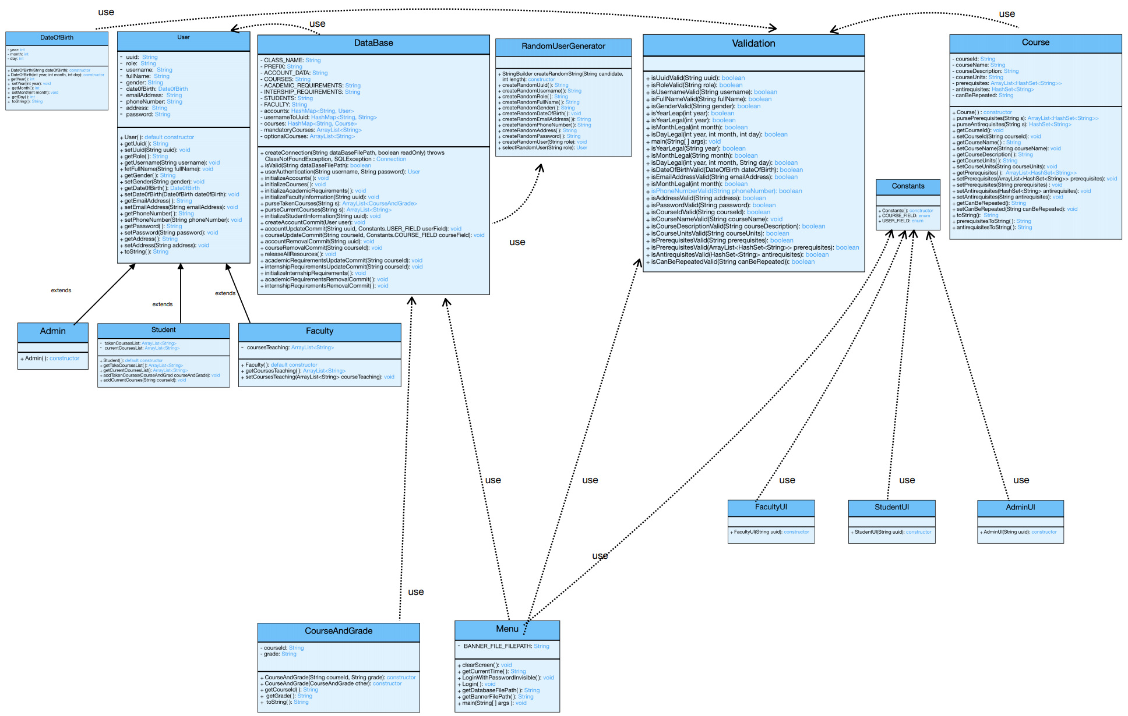
Class Diagram (UML)
https://github.com/alextenney/Group25_Project/blob/master/Project/Demo1/UML_of_DEMO1_Version4.pdf

Slide 6
README File Overview
https://github.com/alextenney/Group25_Project/blob/master/Project/Demo1/README.txt

Slide 7
Demonstration

Slide 8
Next Steps
Complete the recommendation feature in it’s text based version
Create a GUI for a login screen, a homepage for each user type, pages for each functionalities and a logout page.
Finish a web scraper to increase scope of the project (Although is not directly related to the entire project)

Slide 9
Questions and Answers

